Slide 1



FY24 Seaman to Admiral-21 (STA-21)
Mr. David Burmeister
Head, Selection and Placement
NROTC/STA-21
Comm: (847)688-5454x119
DSN: 792-5454x119
Mr. Jim Branch
STA-21 Selections
Comm: (847)688-5454x242
DSN: 792-5454x242
Mrs. Rebecca Ludowise
STA-21 Selections
Comm: (847) 688-5454x243
DSN: 792-5454x243
Email: GRLK_STA21@navy.mil

Slide 2

STA-21 Description
Selectees attend college full-time, year round, at a NROTC-affiliated University.
Strictly Undergrad, no way to pursue graduate studies in STA-21.
Selectees are provided a maximum of up to 36 months to complete a 4yr baccalaureate degree.
Upon degree completion, selectees will become commissioned officers.
Selectees receive full pay/benefits and remain eligible for enlisted advancement while in college. The time spent in the STA-21 program does not count toward retirement, but does count toward time in service for pay purposes.
Selectees receive up to $10k annually (paid directly to the university) for tuition, books, and fees.
2
Notes:
If applicant close to graduation-don’t obtain degree prior to starting program or will become ineligible. Once degree obtained, you now have to apply to OCS.
Commissioned into USN this is a change
Up to 36 mo OR option commissioning age, whichever is soonest
We do not pay for graduate level courses if you complete your degree in less than 36 months

Slide 3
Disclaimer
**This brief is a generalization of the program. All applicants to this program must be familiar with the official directives related to STA-21.
**The FY24 STA-21 Program Announcement NAVADMIN Draft is in the routing chain. All details outlined in this brief are subject to change based upon NAVADMIN final approval by Chief of Naval Personnel.
**Roughly 25% of the selection packages we receive are found to be unqualified for the program for various reasons.
3

Slide 4
STA-21 Directives
OPNAV 1420.1 series (Chapter 8). The STA-21 program changes annually and the STA-21 website has the most up-to-date information.
Program Authorization (PA) for each community, which provide requirements for eligibility, can be found on the STA-21 website.
The STA-21 NAVADMIN is released annually via Naval Message and is also posted on the STA-21 website. This is where you can find what communities are open for that year.
The STA-21 website: https://www.netc.navy.mil/Commands/Naval-Service-Training-Command/STA-21/STA-21-program/
***In the event of a conflict between any of the directives above, please call the STA-21 office for clarification. (847) 688-5454x243, DSN: 792-5454x243 ***
4

Slide 5
STA-21 Eligibility
U.S. citizen. No waivers
Recommended by CO
Active duty member of the Navy or Naval Reserve.
  Including FTS, National Call to Service, and SELRES* (*Must be on active duty throughout the entire application and board process, and will be required to Re-enlist into Active Duty for six years upon selection).
High School Grad/GED complete.
Able to complete college degree in 36 months or less.
Able to commission prior to 31st birthday for Nuclear Option.
  Age requirements for STA-21 commissioning target options differ. Read the authorization guidance for the specific commissioning program
Maintain a cumulative GPA of 2.5 on a 4.0 scale while enrolled.
  Nuclear requires 3.0 on a 4.0 scale.
  IP requires 3.0 on a 4.0 scale.
  CEC requires 2.7 on a 4.0 scale
Must be physically qualified and have passed the previous PRT with a grade of GOOD LOW or better.
Notes:
Citizenship-birth or MUST HAVE naturalization papers with certificate number on it.
CO recommendation- he must recommend – forwarded does not cut it.
USNR must be on AD at time of application THROUGH time the selection results are released. If deactivated after selection, we will reactivate to go to school.

Slide 6
STA-21 Eligibility - (Continued)
SAT: Evidence-based Reading and Writing (EBRW)-500/Math-500 or ACT: English-20/Math-21.
  If applicant is unable to complete an exam due to an overseas assignment or deployment, applicants may still submit with a command letter, signed by the Commanding Officer, indicating the reason for non-availability.
  Applicants without test scores who are eligible for exemption, should ensure their high school cumulative GPA is 2.5 or better on a 4.0 scale and graduation is within the last 5 years OR a cumulative college GPA of 2.5 or better on a 4.0 scale with a minimum of 12 credits as shown on an official transcript.
  Nuclear SAT/ACT waived.
  Those with a 2yr degree will still need SAT or ACT scores or meet high school/college GPA minimum if they have a deployment non-availability.
No record of courts-martial or civilian felony convictions.
No record of DWI/DUI within the three (3) years preceding application deadline.
  Substantiated drug/alcohol incident while in enlisted status will be assessed.
No Article 15, UCMJ, or conviction by civil court for misdemeanors (except minor offenses <$300) during the three (3) years preceding application deadline. Waiver will be considered on a case by case basis.
6
Notes:
Qualifying ACT and SAT scores MUST come from the same test. If you take multiple tests, we will take your BEST scores!
After March of 16 the NEW SAT is reported at Math and Evidenced-based Reading and Writing (EBRW).
To be eligible we require 500 Math and 500 EBRW. Older test was 500 Math, 500 Critical Reading. We will still accept the scores from earlier tests if they are within three years of the 1 July application due date.
ACT and SAT scores must be no older than three years from application due date.

Slide 7

Program Options
Defined annually by NAVADMIN
STA-21
UNRESTRICTED
CORE
NUCLEAR
PILOT
NFO
SWO
EOD
SPECWAR (SEAL)
RESTRICTED
INFO WARFARE
INTEL
SWO/IP
SWO/OCEANO
SWO/ED
HUMAN RESOURCE
INFO PROFESSIONAL
OCEANOGRAPHY
STAFF CORPS
**Red background indicates no select opportunity at this time. The NAVADMIN announcing the program will have more specifics.**
MEDICAL CORPS
NURSE CORPS
CEC
SUPPLY CORPS

Slide 8

Core Option
Must be at least 19 years old and not have passed their 32nd birthday upon commissioning.
Available for active duty Navy enlisted personnel of all ratings.
Must be able to complete requirements for baccalaureate degree in 36 months.
Must complete 2 semesters of calculus and calculus-based physics with a grade of “C” or better.
Maintain a cumulative grade point average of 2.5 or better on a 4.0 scale.
To commission, must pass medical standards in accordance with the Medical Manual, Chapter 15.
Incur a 5 year active duty obligation upon commissioning.
8
Notes:
Calculating Age: All selectees, plan on starting school summer term of each FY selection year. Add 3 years to your age as of summer term and that will determine if you meet the age qualification. Those who would complete the degree in less than three years and prior to the maximum commissioning age would still be considered. Already earned college credits would have to be used toward degree completion.
At service selection (between Jr. and Sr. year) CORE Option selectees will choose from URL communities ONLY. Pilot, NFO, SWO, SPECWAR (SEAL), NUKES and EOD. No CEC, HR, Intel, Information Warfare, Medical, Nurse, Oceanography, or Supply (these are RL and staff communities).
Try and choose CORE as a secondary option if first option is a Target option. You must meet CORE age and vision requirements. If you do this may increase you chances of getting into the community you desire.

Slide 9

Nuclear Option
Time in Service: STA-21(N) candidates must begin coursework at their STA-21(N) university prior to the completion of eight years of military service.
Age: Must complete degree requirements and be commissioned by their 31st birthday. Age waivers may be approved on a case by case basis.
STA-21(N) is only available at specific universities, not including cross-town universities. Selectees must major in technical curricula and maintain a cumulative grade point average (GPA) of at least 3.0 on a 4.0 scale.
Enlisted Source Applicants must:
  Be enrolled in Naval Nuclear Training Pipeline (i.e., Nuclear Field A-School, Nuclear Power School, or a Naval Nuclear Power Training Unit) or,
  Have completed the naval nuclear power training pipeline, hold a nuclear NEC (335X, 336X, 338X, or 339X), and be stationed at any command.
9

Slide 10
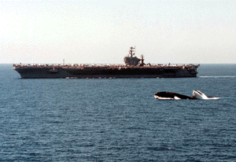
Nuclear Option (Continued)
Gender: Open to both men and women.
Educational Requirements: SAT/ACT waived for Nuclear applicants. Applicants must have finished sufficient undergraduate work to complete requirements for a baccalaureate degree in 36 months.
Medical Standards: All STA-21(N) candidates must meet the physical qualification requirements for submarines and nuclear field duty.
Service Obligation: STA-21(N) selectees incur a five-year active duty obligation upon commissioning.
10
Notes:
We know that you can complete your degree if you attend one of 18 Universities listed on the website.

Slide 11
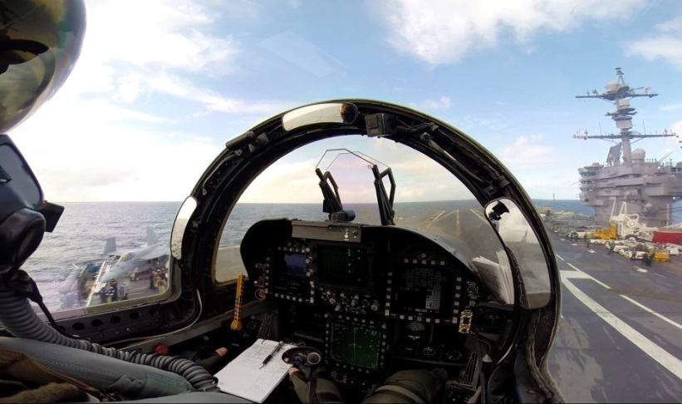
Pilot Option
Able to complete degree requirements and be commissioned by age 32.
Available for active duty Navy enlisted personnel of all ratings.
Achieve a score of Academic Qualification Rating/AQR(4) and Pilot Flight Aptitude Rating/PFR(5) on the Aviation Selection Test Battery/ASTB.
POC for ASTB: (850) 452-2379 or NMOTC-ASTB@med.navy.mil
Must pass Student Naval Aviator flight physical exam, prior to application, to ensure that applicants are fit for aviation duty.
Incur an eight year active duty obligation upon date of designation as a Naval Aviator or six years from date of disenrollment from flight training unless released by the Deputy Chief of Naval Operations (Manpower and Personnel).
11
Notes:
ASTB scores needs to be above qualifying to be competitive. Qualifying scores are 4 AQR/5 PFAR.
Must meet vision qualifications (20/40 correctable to 20/20) at time of application. Prior eye surgery should be PRK or lasEk not lasik. Prior eye surgery still requires a waiver from BUMED and NMOTC so send all pertinent records pre- and post-operative.
Must meet anthropometric measurements at time of application. Please see your local flight surgeon to verify you will meet requirements.

Slide 12
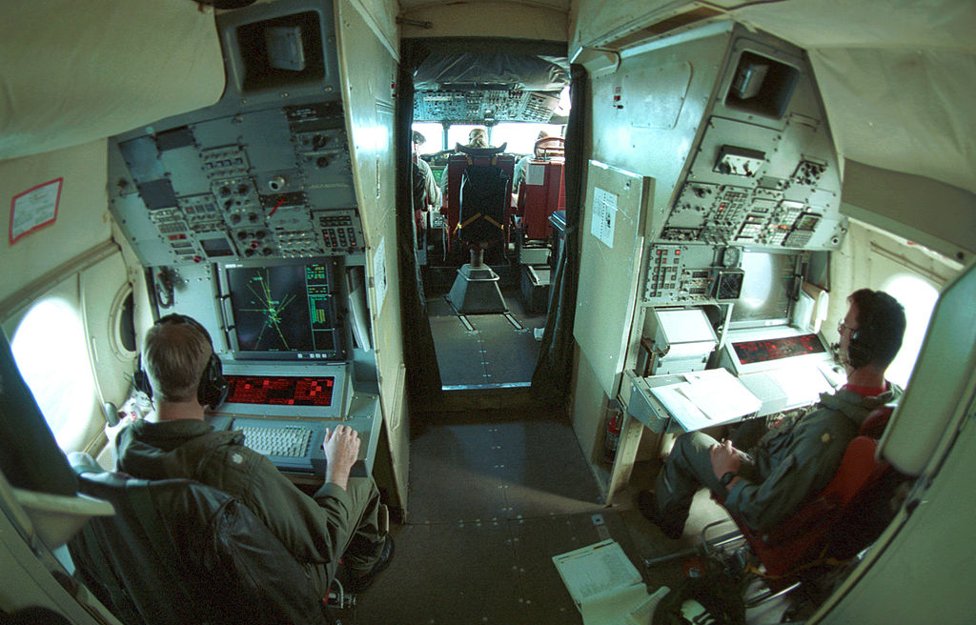
NFO Option
Able to complete degree requirements and be commissioned prior to 32nd birthday.
Available for active duty Navy enlisted personnel of all ratings.
Achieve a passing score of AQR(4) and FOFAR(5) on the ASTB for 1370 applicants. Must pass Student Naval Flight Officer flight physical exam, prior to application, to ensure that applicants are fit for aviation duty.
STA-21 NFO Option officer candidates will incur a six year active duty obligation upon date of designation as a Naval Flight Officer or six years from date of disenrollment from flight training.
12
Notes:
No special vision requirements beyond commissioning standards. ASTB required 4 AQR/5 FOFAR.

Slide 13

SWO Option
Able to complete degree requirements and be commissioned prior to 35th birthday. No Waiver!
Available for active duty Navy enlisted personnel of all ratings.
To commission, must meet medical standards in accordance with the Medical Manual, Chapter 15.
STA-21 SWO Option selectees will incur a five year active duty
obligation upon commissioning.
13

Slide 14

CEC Option
Able to complete degree requirements and be commissioned prior to 42nd birthday.
Have sufficient college credits to complete ABET engineering degree or NAAB architecture degree within 36 months.
Must maintain a 2.7 minimum grade point average on a 4.0 scale. Preferred degrees are civil, mechanical, ocean and electrical engineering.
Open to all ratings. Selectees must have at least four years of active duty (of which at least three years were in an other than formal training environment as of the scheduled start of Naval Science Institute (NSI) for year applying.).
Medically qualified (Same as Core Program with exception that color vision deficiency is not disqualifying).
Incur a 5-year active duty obligation upon commissioning.
www.npc.navy.mil/Officer/BUPERS-316E/CivilEngineerCorps
14
Notes:
Open to men and women of all ratings.
ABET: Accreditation Board for Engineering & Technology
NAAB: National Architecture Accrediting Board

Slide 15

SPECWAR (SEAL) Option
Must be at least 19 years old, able to complete degree requirements, and not have passed their 42nd birthday at the time of commissioning.
Must pass physical qualification IAW Medical Manual, Chapter 15, including qualification for Special Operations Duty.
Incur five-year active duty obligation upon commissioning.
Applicants must carry the O26A or O23A NEC and not have begun their LPO milestone.
Contact SEAL OCM at SEAL_OCM@navy.mil for required package components.
Open to both males and females.
15
Notes:
Must be a SEAL.
SDAP pay will continue if: You need to be selected for SPEC WAR Option and maintain your current SEAL qualifications. You will also need to continue performing the SEAL PRT. Recommend picking a school that is near a base/team that can oversee the yearly assessment of qualifications.

Slide 16

Explosive Ordnance Disposal (EOD)
Selectees must be at least 19 years old and must be able to complete degree requirements and be commissioned prior to 35th birthday. No waivers are available for this program.
Open to active duty Navy enlisted personnel.
Applicants must have one of the following enlisted EOD NECs: M02A, M03A, M04A, M1DV, M2DV, B16A, B17A, L27A, or L28A.
Must pass physical qualification in accordance with the Medical Manual, Chapter 15, including qualification for diving duty and/or combat swimmer.
Incur five-year active duty obligation upon commissioning.
16
Notes:
Require one of the following NECs: 5332/33/34/35/36/37/42/43 and 8493/94. No waivers for the NEC’s will be given!
SDAP pay will continue if currently receiving, selected for EOD option, and maintain your qualifications (NEC).

Slide 17

Nurse Corps Option
Must be at least 18 years old. Must complete degree requirements and be commissioned prior to 42nd birthday.
Available for active duty Navy enlisted personnel of all ratings.
Exempt from the Calculus and Physics requirement of STA-21 Core program.
  Must meet math/science requirements of Nursing degree program.
Must have completed a minimum of 45 quarter, or 30 semester credit hours in undergraduate nursing prerequisite courses; Psychology, Biology, Chemistry, Organic Chemistry, Anatomy and Physiology, Microbiology, Nutrition, Sociology, History, General English and Math.
Available only at specially identified NROTC affiliated colleges or universities with nursing programs that confer a Baccalaureate Degree in Nursing that is accredited by the NLNAC or the CCNE.
Must meet licensure requirements.
Selectees will incur a five-year active duty obligation.
17
Notes:
Look and make sure you can get accepted at the College of Nursing not just the University. Many schools will not accept you into the nursing program until the beginning of your junior year. If you are not competitive and don’t get accepted, you will be returned to the fleet in an enlisted status.
Recognize nursing programs are very linear . Courses are usually taken and offered in a set sequence. It can be difficult to complete in 3 years with out completion of prerequisites.
Credit hours may be a combination of traditional classroom courses, college level entry program (clep) credit, on-line or distance learning programs, or military training credits provided the school to which the application is made accepts the non-traditional credits. Your record would be favorably reviewed if you have lots of science, Anatomy and Physiology, Biology, Chemistry, Organic Chemistry, etc.

Slide 18
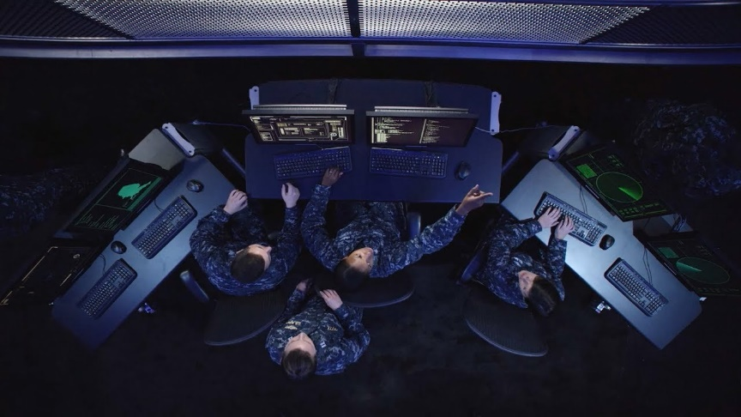
Information Professional Option
Must be at least 18 years old and be able to complete the degree requirements and be commissioned prior to 42nd birthday. No waivers will be considered.
This option is open to men and women of all ratings.
Participants must maintain a cumulative 3.0 or higher GPA on a 4.0 scale.
Must pass physical standards in accordance with the Medical Manual, Chapter 15 – color blindness not disqualifying.
Applicants who are selected, must have a current TS/SCI clearance or provide proof that TS/SCI documentation has been submitted.
Applicants are required to pursue fields of study directly related to science technology, engineering and mathematics.
Incur a 5 year active duty obligation upon commissioning.
18
Notes:
SCI is Special Compartmental Information…above top secret.

Slide 19

STA-21 Program Application
Part 1 On-Line Application:
    https://netfocus.netc.navy.mil/Gateway/sso.aspx
    Statistical Data
    Check Application Status
    Update Application
Part 2 Mail-In Portion:
    Naval Service Training Command
    Attn: N92/STA-21
    320A Dewey Ave Building 3, Room 106
    Great Lakes, IL 60088-2845
    Preferred method of delivery is
    through mail. If mail delivery is
    not possible, contact N92 at
    grlk_sta21(at)navy.mil for
    alternative delivery methods.
19
Notes:
Online application
-Password must be at least 8 characters long.
-Stats data utilized by board. If no computer access, mail in additional data form as part of your packet.
-Check application status will tell you what is missing or needed. We put the info in there.
-View update app page periodically-information is posted on this page to alert you. Update duty assignment status with contact information!!!!
Part 2
New mailing address

Slide 20
STA-21 Program Application (Continued)
Applicant’s Responsibility:
  Application cover letter
  Personal statement – signed and dated
  Evals (last 5) – front and back
  SAT/ACT scores
  ASTB (Pilot or NFO only)
  High school transcripts or GED.
  College Transcript(s) – if applicable. In order to receive credit for an Associates degree, it must be documented on JST or College transcript.
  JST (Joint Service Transcript)
  Additional documents (NEC, qualifications, awards, page 4s, etc.).
  Current PFA/PRT result printed from PRIMS – or CO statement
  Nuclear personnel only – an approved NAVPERS 1306/7 by OPNAV (N133), and detailer (Pers-403), is required for all Nuclear trained personnel who are applying for non-nuclear Officer commissioning program.
  Page 13 Statement of Understanding for Primary Option and CORE* (*if secondary option is applicable)
20
Notes:
Cover letter-use website cover letter. Correspondence manual may help with formatting. (SECNAVINST 5216.5D)
10 or 12 font-one page only
Personal statement should include request for waiver of any type. Statement should be about why you want to be a Naval Officer.
5 evals-no holes. NOB submit. Remember to copy the back!
SAT/ACT scores MUST be in the package! Updated scores can be forwarded after app in but original scores must be in packet.
Qualifying ASTB scores for Pilot and NFO MUST be in the package!
Transcripts-front and back, certified true copies (for all enclosures). Transcripts required not Diploma.
Transcripts can be sent to student and opened at command for certification (they do not need to be sent directly to us).
Pictures for nukes only. Page 13 for Primary & Secondary if applying for both.
PFAs (3) via PRIMS printout. Failure within a year of application is disqualifying.
If downloading pages from website, please remove headers and footers.
Utilize check sheet to ensure you have sent all documents. Your application represents you to the board. Be thorough and be early.
Be prepared for your interview. Know your goals, why you chose the option you did, COC, current events, how you will handle responsibility and decisions etc. Look sharp, hair, uniform, shoes, posture, (women, hair, nails, earrings). Be respectful, make eye contact and try not to reflect anxiety/nerves. Even if you know the board, remember you are interviewing for a job-don’t be overly familiar.
Don’t waste time and money by using fancy folders or document protectors. Use bulldog clip not staples and send in plain large envelope. Remember to keep a copy for your records!!! We will not return applications.
Once the applicant turns the package in to the command, they should not see it again. The command will take over from here!

Slide 21
STA-21 Program Application (Continued)
Command’s Responsibility:
  CO Endorsement letter with ranking- signed and dated
  CO Recommendation Form
  Interview board appraisal sheets (3) – CO does not submit one.
Nomination Review Board’s Responsibility:
  NRB Chairperson Recommendation Form
  Interview board appraisal sheets (3) – NRD Chair does not submit one.
  Interview Verification Form – signed and dated by both Commanding Officers
21
Notes:
CO’s endorsement
If waiver requested, CO should comment on it.
If Command wants you to do rough endorsement, DO IT! And don’t be shy or humble!
If Command doesn’t fulfill their responsibilities, you won’t be penalized. Stay up to date using the application status portion of the web site.
Ensure one rep from chosen option on board. All 03 and above.
In ranking, consider how rank will help or hurt based on comparative group. Will you rank all candidates or like groups of candidates.
Does the CO recommendation match the evaluations recommendations?
Nom boards
must be justified in the CO’s endorsement if not done
Nom Chairman doesn’t have to be senior to CO, but must not be in the chain of command (i.e., not subordinate to the CO)
Chairman can be member of board (1 of 3 or 1 of 4). Ensure designators and job titles are on sheets for 03 or above.

Slide 22
STA-21 Program Application (Continued)
*Application Deadline*
  Applications must be post-marked NLT than 1 July.
  Those applications received missing information listed or postmarked later than the due date will not be eligible for the Selection Board. Extenuating circumstances will be considered on a case by case basis and should be addressed in CO’s endorsement.
22
Notes:
All applications from one Command can be mailed together but is not required.
Package must be complete AT THE TIME IT IS MAILED! If not complete by 1 July you are ineligible.
Must meet basic requirements by 1 July but if additional data will help you after 1 July- you may mail/fax/email updates (ex: new higher test scores). Call us to ensure receipt.

Slide 23
STA-21 Program Application
(Screening Procedures)
Check applicants age compared to the Option in which they are applying.
Don’t forward packages that lack CO’s recommendation.
Address discrepancies in application (i.e. missing statement(s) of understanding, lack of HS and/or college transcripts, missing interviewer’s appraisal sheets, eval gaps, prior scholarship attempts, copies of awards or anything that is not readable).
23
Notes:
All applications from one Command can be mailed together but is not required.
Package must be complete AT THE TIME IT IS MAILED! If not complete by 1 July you are ineligible.
Must meet basic requirements by 1 July but if additional data will help you after 1 July- you may mail/fax/email updates (ex: new higher test scores). Call us to ensure receipt.

Slide 24
Selection Board Emphasis
OFFICER POTENTIAL
Fleet performance
Leadership
Willingness to assume responsibility
Advancement record
Officer comments
Physical fitness
ACADEMIC POTENTIAL
High School Transcript
College Transcript
Joint Service Transcript
SAT/ACT Scores
24
Notes:
Board is 1-2 weeks long. Each record is reviewed by a minimum of 3 senior naval officers with at least one of the same designator as the option choice.
Many of board members are COs and XOs themselves.
Board process reviews every record (even those determined not qualified) for quality assurance. Then in the process the cream of the crop float to the top, the less competitive to the bottom and the hard to sort to the crunch. Crunch records are often most likely reviewed again by up to 5 members. It is like swimming competitions where the difference can be as small as a thousandth of a point.
The board is concerned with the “WHOLE” person concept!

Slide 25
Selection Board Comments
Most important part of package is CO endorsement (consistency, comments, leadership experience).
Try to get more senior people to conduct external Interview boards. (Specific community applicant is applying to should be represented).
Applicant’s personal statement should explain any weaknesses or special circumstances (deployment, poor HS grades, etc.). Must specify option(s) applying for and why.
Gain as much off duty education as possible prior to applying.
Technical Courses/Degrees hold a lot of weight with the board. (Shows an ability to complete Calculus/Physics)
Applicants should gain recommendations outside of their COC. (Past CO’s, CMC’s, HS coaches, etc.)
Sailors selected as alternates should state this status in package when reapplying.
25

Slide 26
Trends
Early completion - Do you have college credits and/or your AA/AS?
Service over self
PFA - Do better than the minimum
Average selectee SAT: 1200+
College credits - Calculus, Physics, College Algebra etc., math is important!
College grades - 2.50 GPA or higher, shows an ability to complete college coursework. The more rigorous the curriculum and the higher the GPA, the more you will stand out.
Whole Person - community involvement, outside activities.
26
Notes:
Whole person – for junior personnel remember to include High school activities

Slide 27
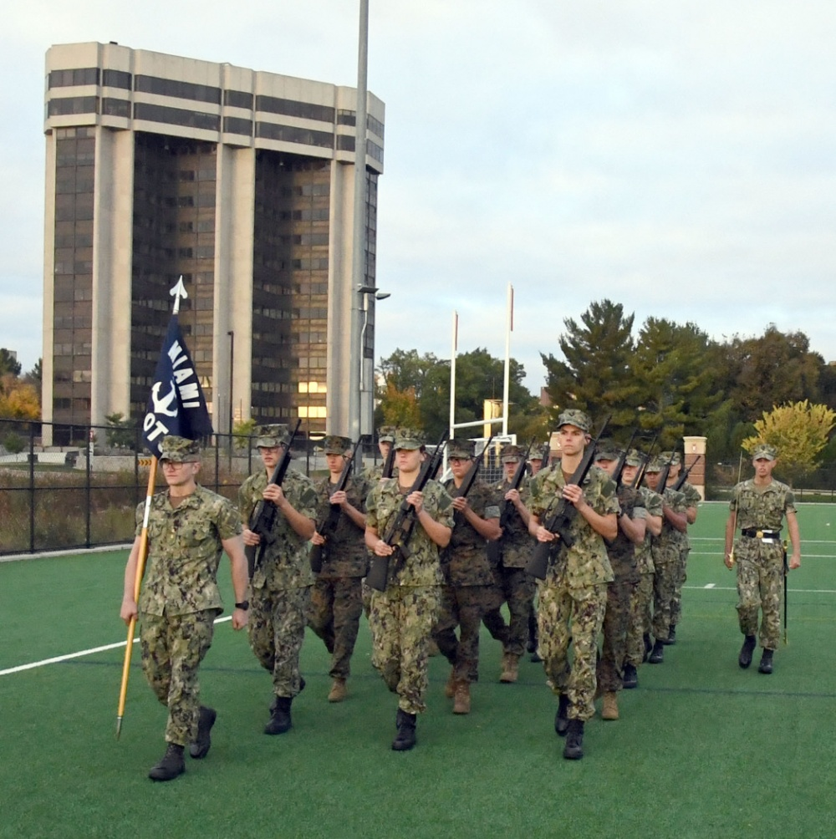


STA-21 Education Paths
SELECTION
NSI
College
Commissioning

Slide 28

Seaman to Admiral-21
At the University…
  Assigned to an NROTC unit as an Officer Candidate.
  Remain on active duty…receive pay and allowances. Time does not count towards officer retirement but it does count for pay purposes.
  Complete degree program within 36 months and prior
  to age limit for assigned option.
  Complete two semesters of calculus and calculus-based physics. (Exception: Nurse Option.)
  Attend unit established drills, labs,
  GMT, etc.
  Maintain all eligibility requirements
  Service Selection (Core option only.)
28
Notes:
Once in the program – you must maintain all eligibility requirements.
GOOD LOW – PFA
2.5 GPA
2.0 in Calculus and Physics (each semester)
No alcohol incidents
Poor judgment – no NJPs

Slide 29
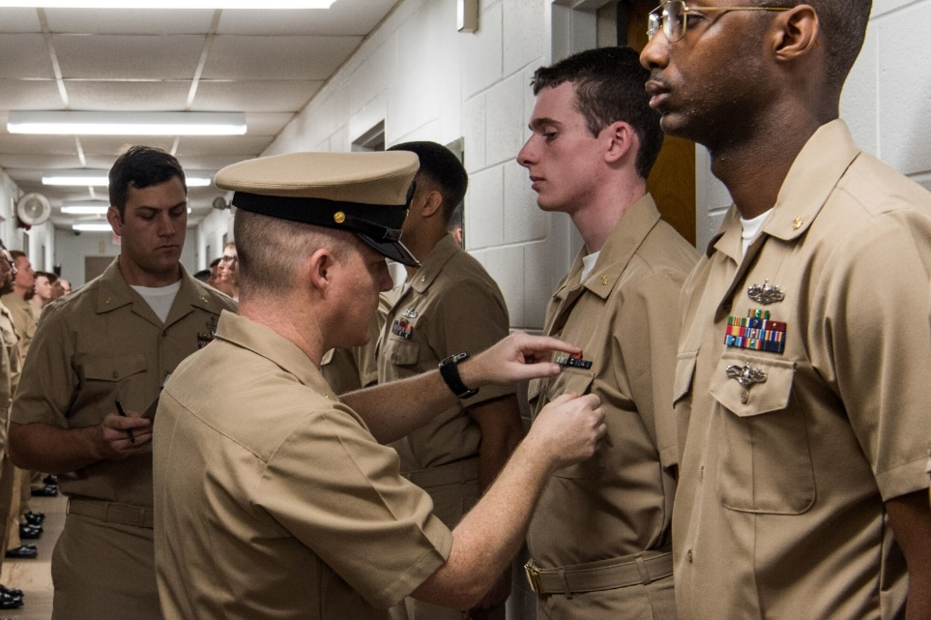
Naval Science Institute - OTC Newport
Two six week courses starting in February and April
Covers Professional Military Education:
  Introduction, Sea Power and Maritime Affairs
  Naval Sea Systems I and II (Engineering and Weapons)
  Navigation and Naval Ops
Physical Readiness Training
Swimming Qualifications
Receive Officer Candidate uniforms
29
Notes:
Once in the program – you must maintain all eligibility requirements.
GOOD LOW – PFA
2.5 GPA
2.0 in Calculus and Physics (each semester)
No alcohol incidents
Poor judgment – no NJPs

Slide 30
STA-21 Milestones
Application Opens Feb 2023
Application Deadline 1 Jul
Selection Board Aug/Sep
NAVADMIN of Selectees Oct
Begin NSI Feb/Apr 2024
Begin College* Sum/Fall
* Not all participants will begin at same time
30

Slide 31
STA-21 Information
Commercial: (847) 688-5454x243
DSN: 792-5454x243
Email: GRLK_STA21@navy.mil
Website: https://www.netc.navy.mil/Commands/Naval-Service-Training-Command/STA-21/STA-21-program/
31

